Slide 1
the KCDB 2.0: CMC review www.bipm.org/kcdb
Author: BIPM
Version: 5
Last update: 3022-05-31

Slide 2
Content
Submit CMC for intra-RMO review
Intra-RMO review
JCRB review = Inter-RMO

Slide 3
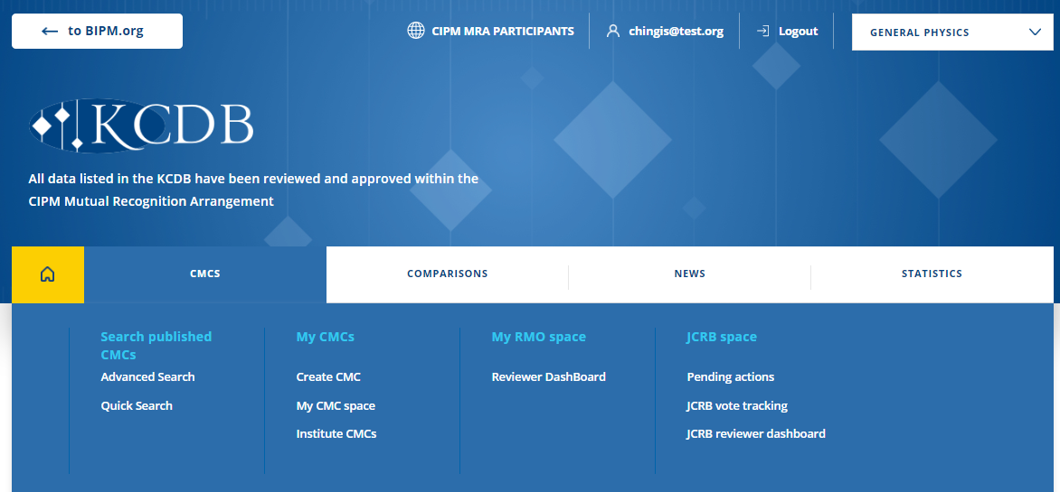
Writer
- Create CMC or modify CMCs via “My CMCs” menu…

Slide 4
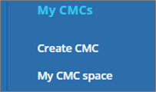
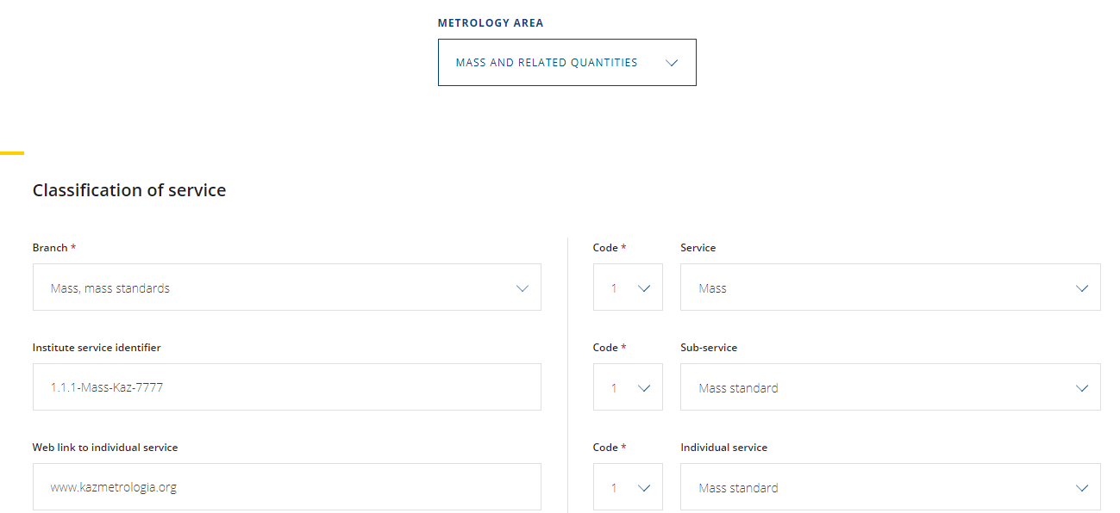
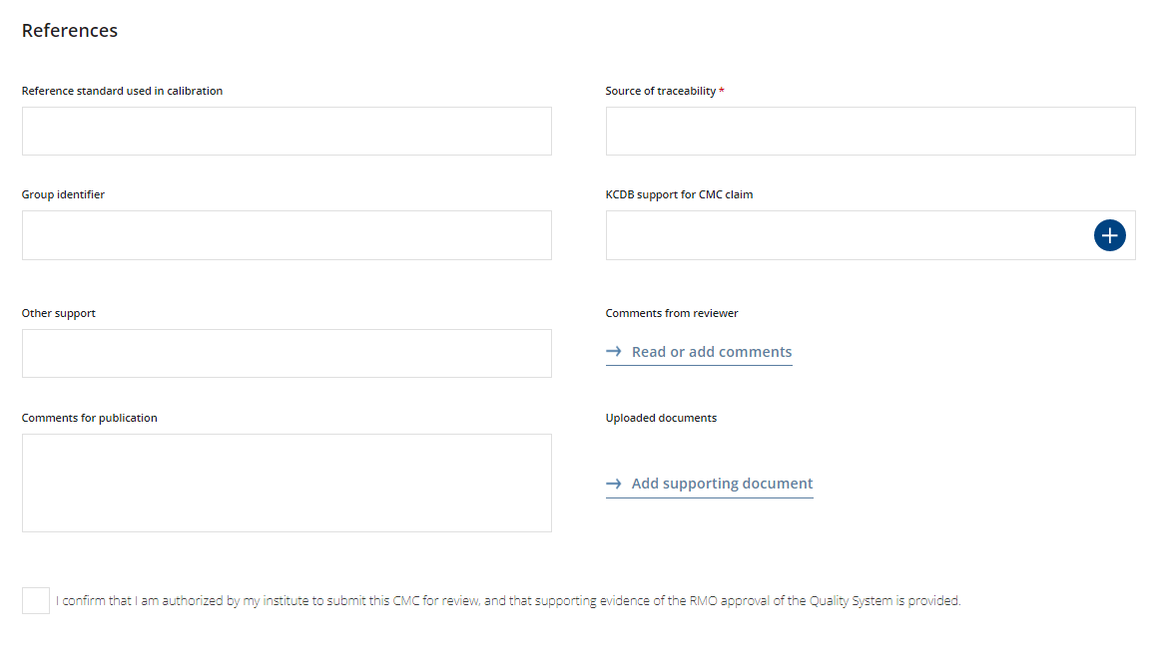
Writer
- Create a new CMC
Comments published on the open KCDB web site
Create CMCs

Slide 5
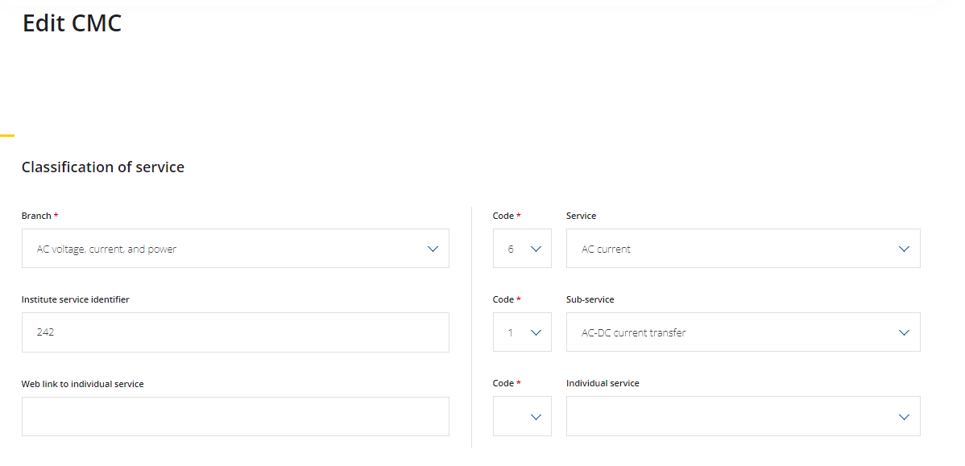
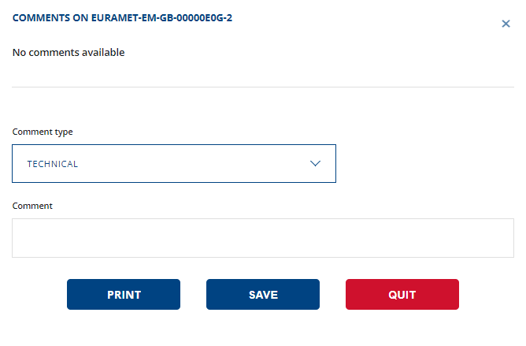
Writer
…or mpodify an already existing CMC
Comments not published on the open KCDB web site, but aimed for review communication
ALWAYS describe in what the modification consist to inform the reviewer.

Slide 6
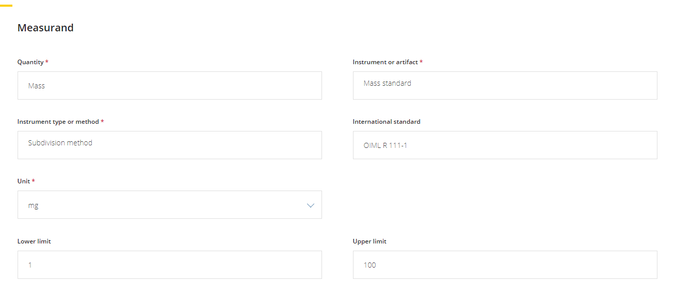
Writer
- Submit CMC for intra-RMO review
Create CMCs
Once you have completed all fields in CMC development, you can directly submit through… (Option 1)
When you are confident with created/modified CMC…
Option 1

Slide 7
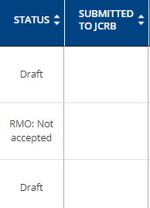
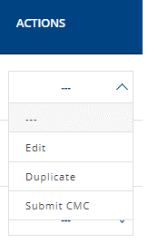
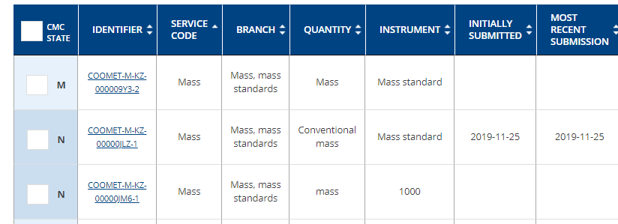
Writer
- Submit CMC for intra-RMO review
Select “DRAFT” CMCs and…
Option 2
“SUBMIT CMC”
˅
…or submit CMC through actions menu
Option 3
˅

Slide 8
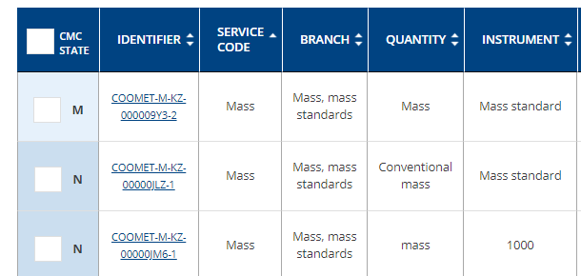
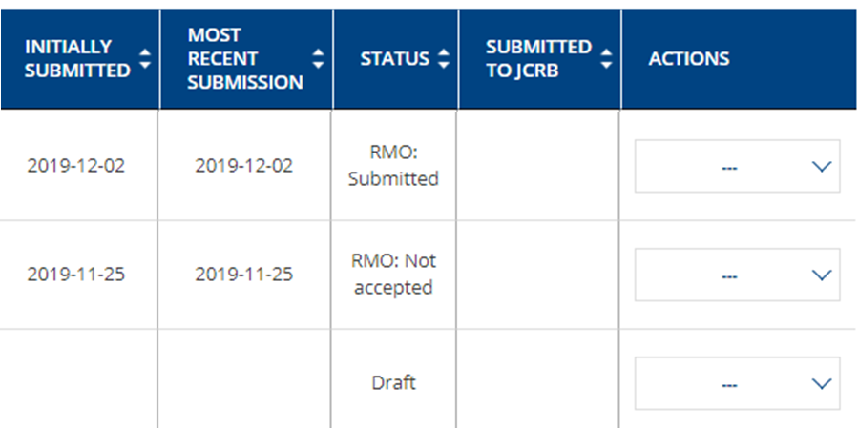
Writer
- My CMC space
No actions allowed by writer…
Once the CMC has been submitted, it is no longer available to the Writer to modify data.
Status of CMC is changed to …
No actions are allowed by writer until the review is completed. Writer can read comments made by reviewers and TC Chair.

Slide 9
Intra-RMO review
The intra-RMO review has been designed to mirror the JCRB (inter-RMO) review.
The CMC may be revised an unlimited number of times.
Set date limits are not programmed and are hence, in respect to the software, not fixed.

Slide 10
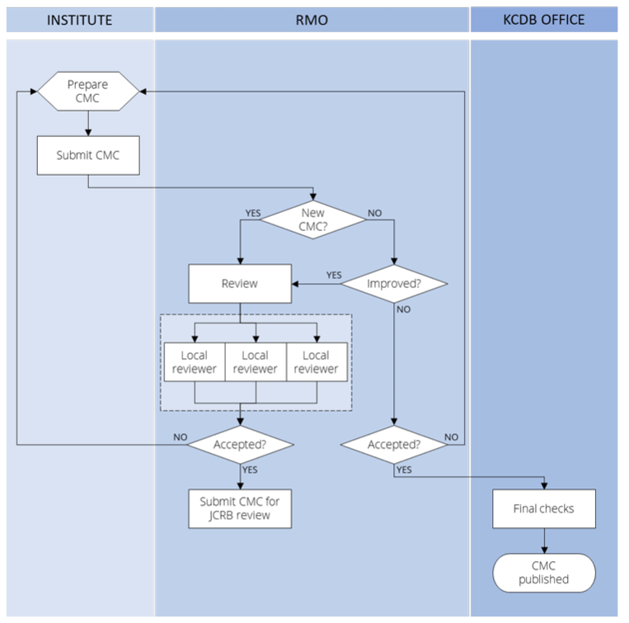
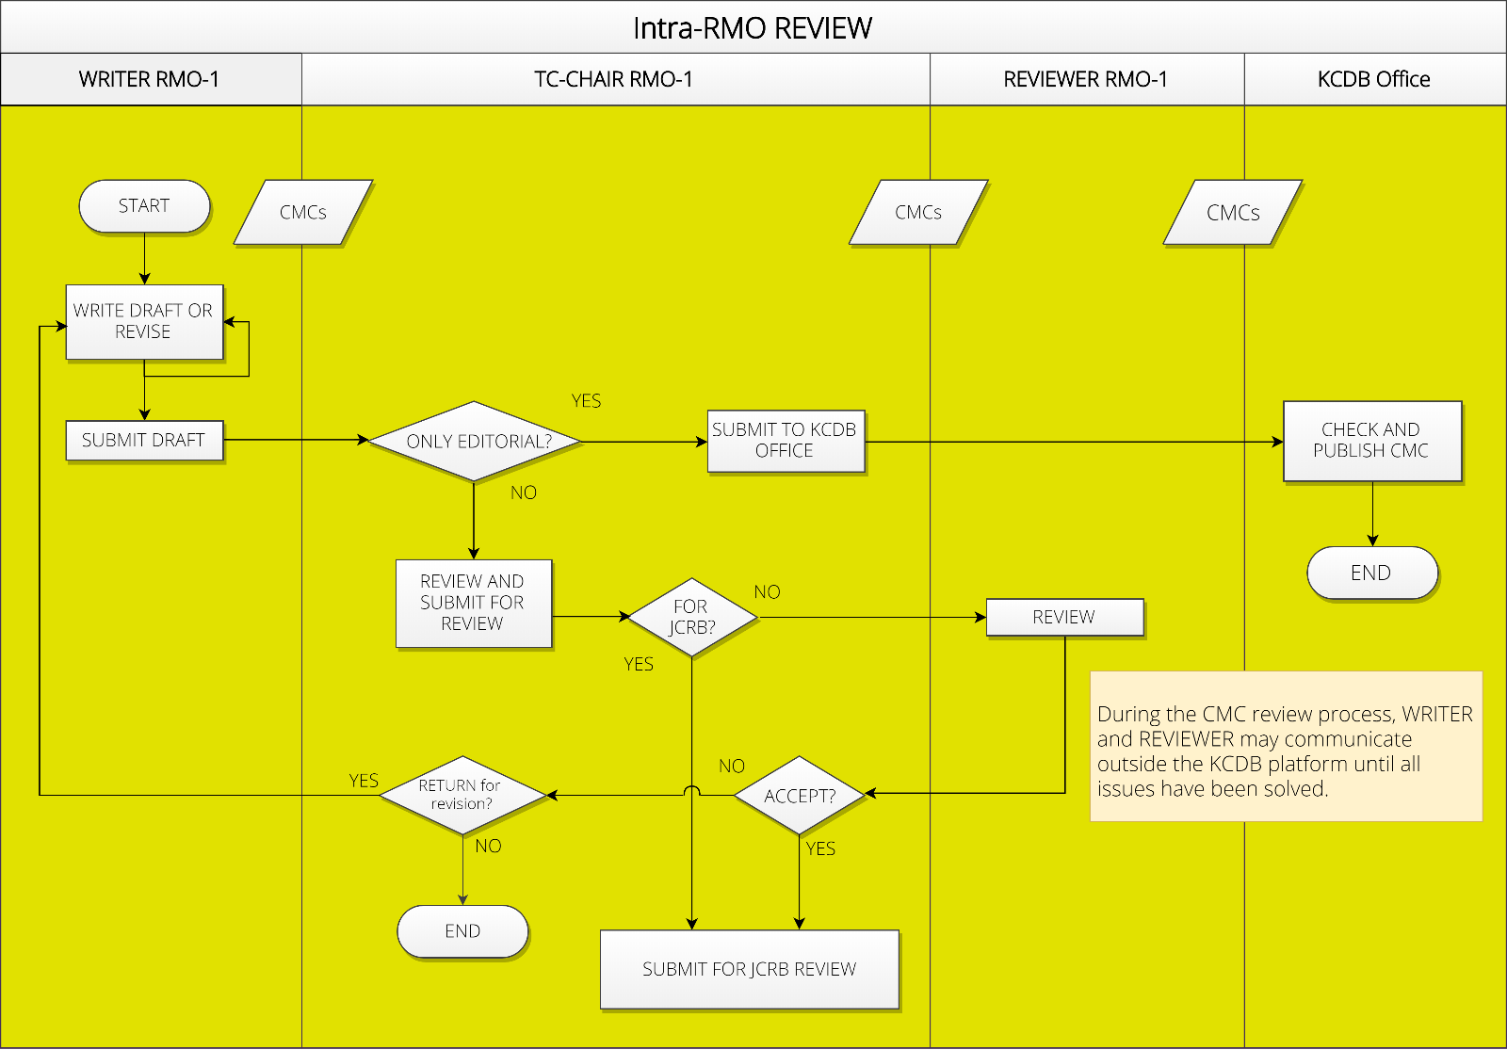
Users involved in the CMC review process
E-mail notifications are automatically generated at each step of the review process and distributed to the involved persons (Writer, TC Chairs, WG Chair, JCRB Executive Secretary and KCDB Office)

Slide 11
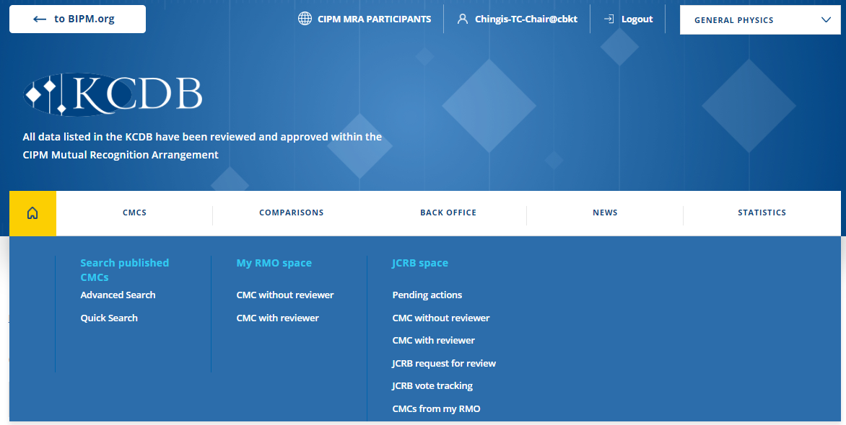
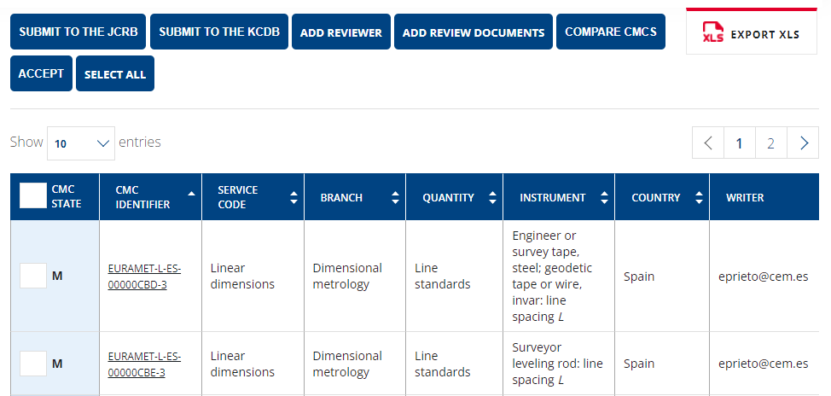
TC Chair’s space
All CMCs submitted by the Writers within the RMO for intra-RMO review are first available in “CMC without reviewer”.
Confidential
Confidential

Slide 12
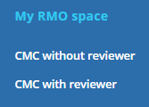
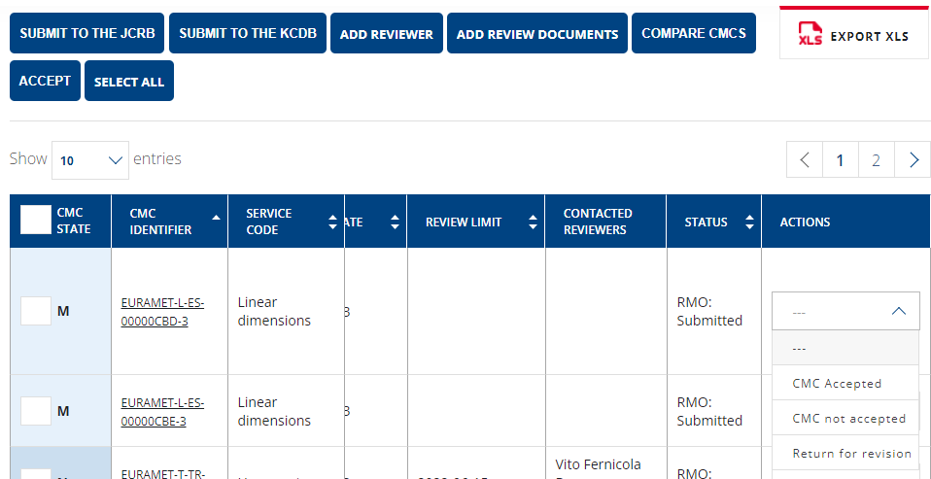
Intra-RMO review: TC Chair
TC Chair may review a CMC without engaging an external reviewer.
TC Chair may review a CMC without engaging an external reviewer.
TC Chair can review through the actions menu:
Accept
Not accept (definitive)
Return to WRITER for revision
˅
…the CMC will no longer be available in “CMC without reviewer” but will become available in the dashboard “CMC with reviewer”.
Confidential

Slide 13
Intra-RMO review: TC Chair
After review, if the TC Chair is confident on the CMCs, the CMC can be submitted directly to the JCRB for review.
˅
Confidential

Slide 14
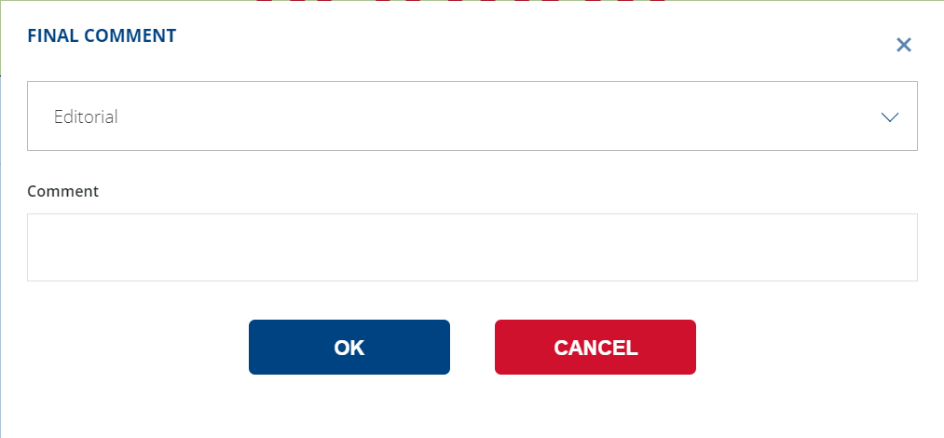
Intra-RMO review: TC Chair
CMCs having undergone uniquely editorial modifications, reduced measurand range or increased uncertainty can be submitted directly by the TC Chair to the KCDB Office for publication in the KCDB. This should be indicated in the comments by the Writer or TC Chair as information to the KCDB Office.
CMCs having undergone uniquely editorial modifications, reduced measurand range or increased uncertainty can be submitted directly by the TC Chair to the KCDB Office for publication in the KCDB. This should be indicated in the comments by the Writer or TC Chair as information to the KCDB Office.
˅
Confidential

Slide 15
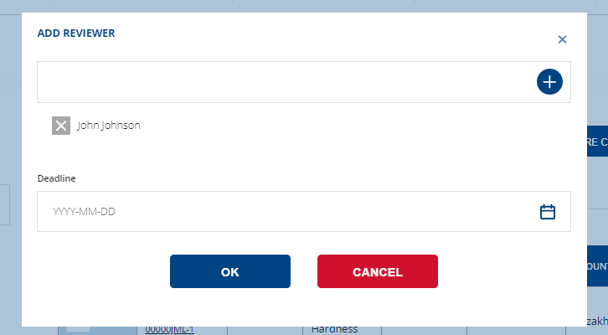
Intra-RMO review: TC Chair
External reviewers and the TC Chair may review the same CMC, if necessary, but the TC Chair should wait for the review reply and the TC Chair reply will be the final decision.
The TC Chair may ask experts within the same RMO to review one or several CMCs.
…all Reviewers that have user accounts and who cover the same expertise can be selected by the TC Chair.
The date limits for review are set by the TC Chair.
˅

Slide 16
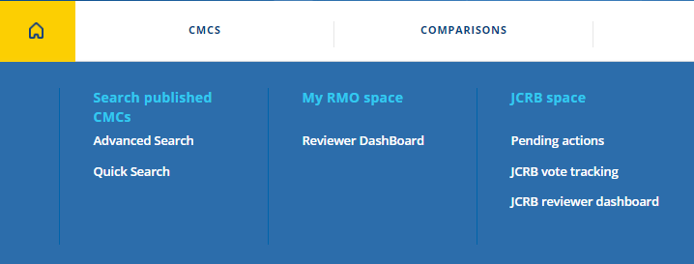
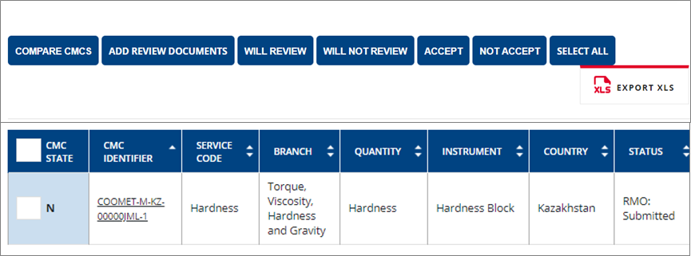
Intra-RMO review: Reviewer

Slide 17
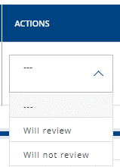
Intra-RMO review: Reviewer
“Accept” or “Not Accept” can be available only after indication “Will review”.
Once the reviewer has indicated whether to accept or not accept the CMC, the CMC is no longer displayed in the dashboard.
If the Reviewer indicates “Will not review” the CMC is no longer displayed in the dashboard.
Reviewer also can click to an appropriate action.
˅

Slide 18
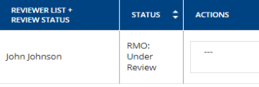
Intra-RMO review: TC Chair
Once the Reviewer has clicked “will review”, the CMC will appear on the TC-Chair “CMC with reviewer” dashboard with the name of the reviewer.

Slide 19
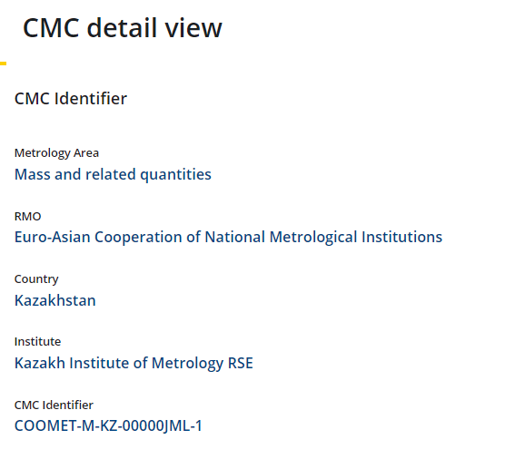
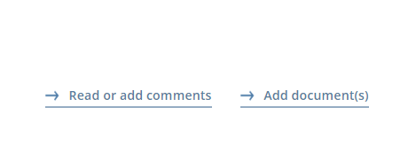
Intra-RMO review: Reviewer
Reviewer can add comments specifying the type of comments (TECHNICAL, EDITORIAL, MISSING EVIDENCE, OTHER)
…or can add review report or other supporting document that helps to the revision process.
Reviewer can click to review.

Slide 20
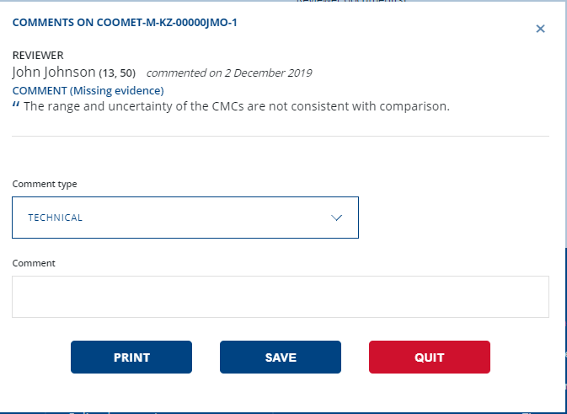
Intra-RMO review: TC Chair
CMCs that have comments are highlighted in BOLD. Review comments can be viewed through on the CMC page.

Slide 21
Intra-RMO review: Writer
CMC is under review.
No actions allowed by writer until the review is completed.

Slide 22
Intra-RMO review: Writer
No actions allowed by writer until the review is completed. Writer can read comments made by reviewers and TC Chair.
Review comments can be viewed through on the CMC page.

Slide 23
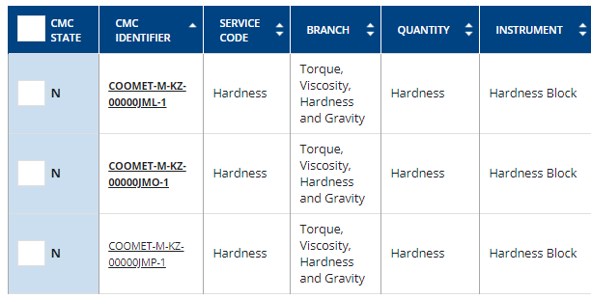
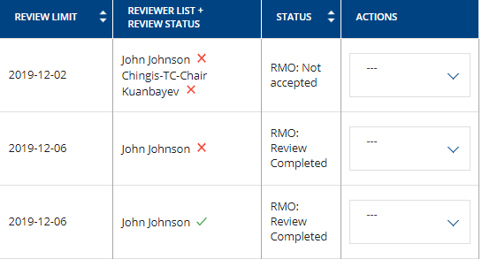
Intra-RMO review: TC Chair
Reviewer has completed the review: the TC Chair can see:
green “tick” = “Accepted”
red “cross” = “not accepted”.
Writer can only see the status of CMCs.

Slide 24
Intra-RMO review: TC Chair
Not accepted, CMC will not go further.
TC Chair can return the CMC for revision.
TC Chair can “Accept” CMC and submit to the JCRB review.

Slide 25
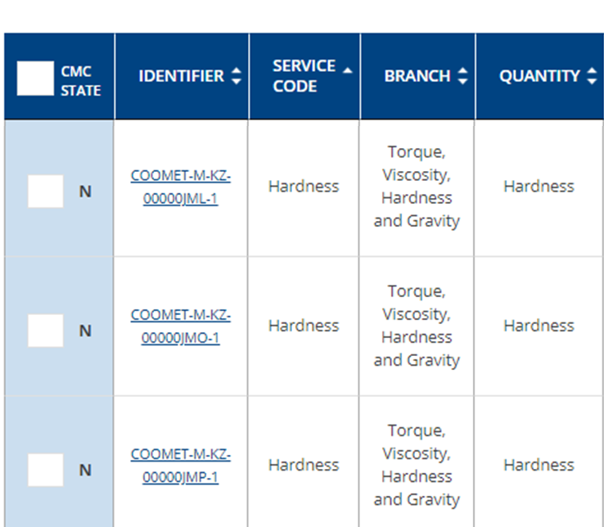
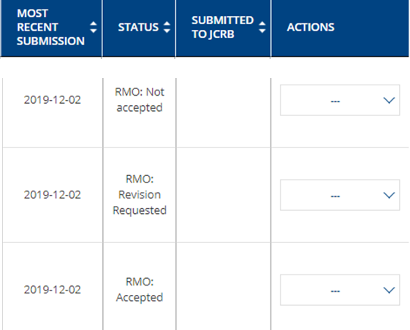
Intra-RMO review: Writer
When TC Chair returns CMC for revision, Writer can edit CMCs and submit again for review.
The Writer may re-submit a revised CMC an unlimited number of times during the intra-RMO review.

Slide 26
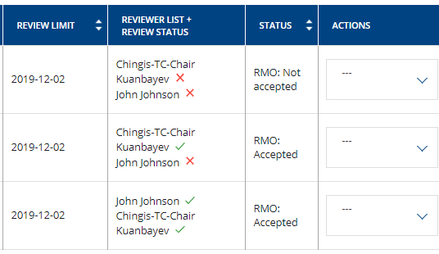
Intra-RMO review: TC Chair
…and submit to the JCRB review.
˅
TC Chair can “Accept” CMC…
˅

Slide 27
JCRB review
There are a few distinct differences for the JCRB review compared to the intra-RMO review:
Date limits are fixed and follow the JCRB rules.
If all reviewing TC Chairs approve the CMC without request for revision, the CMC will not be submitted to vote but will automatically become available to the KCDB Office for publication.
If at least one of the reviewing TC Chairs asks for revision, the revised CMC will be submitted for vote.
A CMC can only be revised once by the Writer.
The outcome of the review is concluded at the latest date set for review limit by the reviewing TC Chairs.

Slide 28
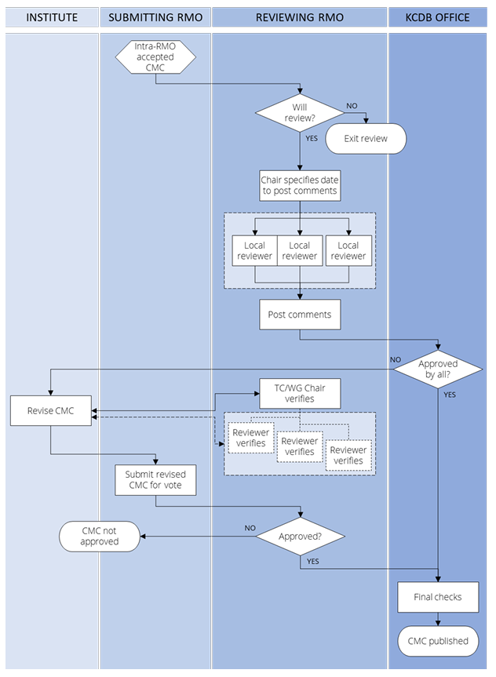
Users involved in the CMC review process
E-mail notifications are automatically generated at each step of the review process and distributed to the involved persons (Writer, TC Chairs, WG Chair, JCRB Executive Secretary and KCDB Office)
During the CMC review process, WRITER and REVIEWER may communicate outside the KCDB platform until all issues have been resolved.

Slide 29
JCRB review deadlines
RMO 1: submits CMCs
RMOs 2 to 6: review and approve
Promised date to review =
DEADLINE for submitting review report
RMOs Indicate intention to review
RMO 1 submits revised file
3 weeks
Final voting
RMO 2
RMO 3
Publish
RMO 1 submits CMC to the JCRB review
RMO 4
Reminders before chosen date:
3 weeks
1 week
RMO 5
RMO 6
3 weeks

Slide 30
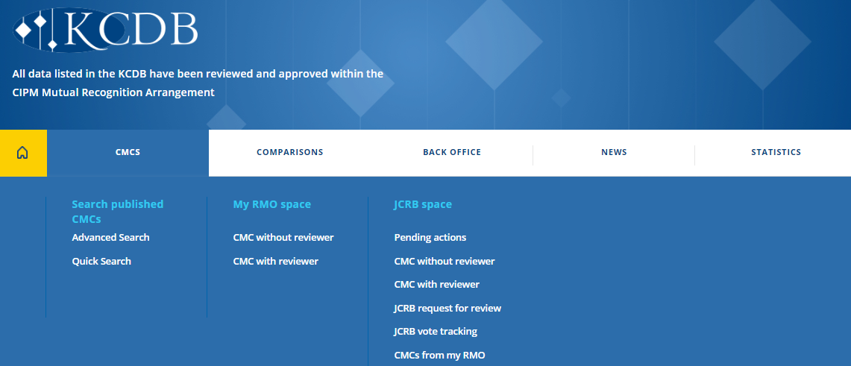
JCRB Space:
When the originating TC Chair has submitted CMCs to the JCRB for review they are listed here:
When the reviewing RMOs have indicated “Will review” the CMC will appear here, and the tool allows to select the local reviewers.
Once the reviewing RMOs have selected the local reviewer, the CMCs will appear here.
Reviewing RMOs can indicate their intention to review: “Will review” or “will not review”
The results and status of the voting process may be consulted in the dashboard.
Originating TC Chair can find own CMCs here:

Slide 31
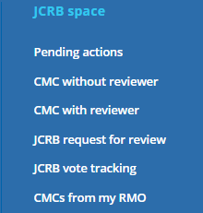
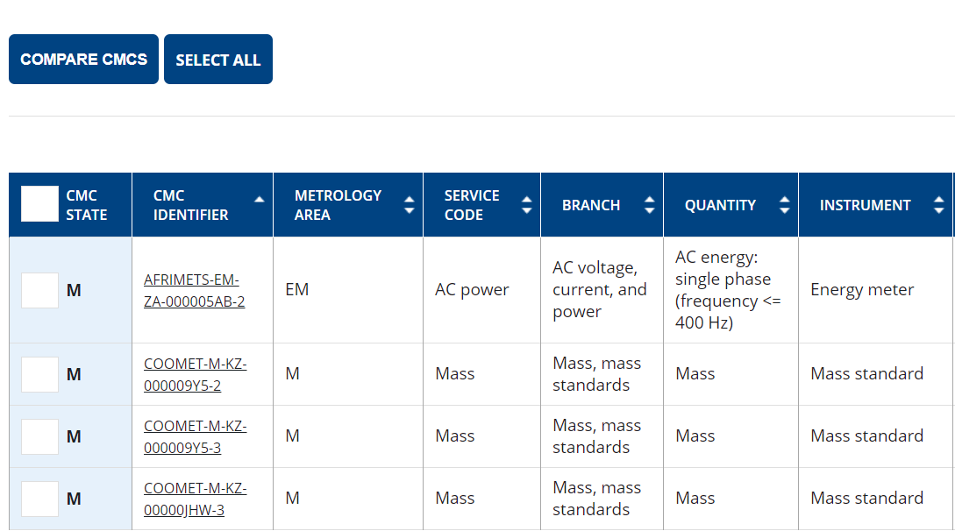
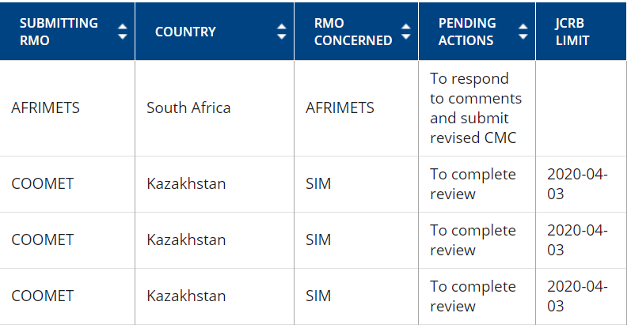
JCRB Space: Pending Actions
The pending actions indicated are:
Acknowledge receipt of submitted CMC
To complete review
To respond to comments and submit revised CMC
Proceed to vote

Slide 32
JCRB review: Originating TC Chair
CMCs that have been submitted to the JCRB are available in the menu JCRB space “CMCs from my RMO” dashboard.

Slide 33
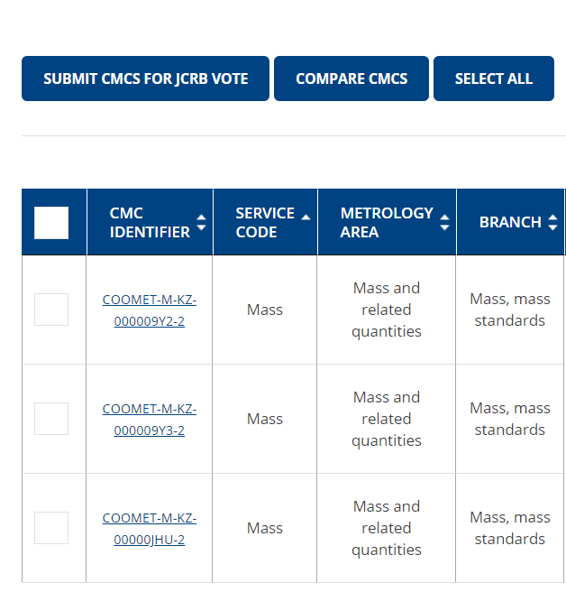
JCRB review: Originating TC Chair
The TC Chair may also submit CMCs for vote in this dashboard.
The TC Chair has the possibility to follow the review progress.
CMC status “Submitted to the JCRB”

Slide 34
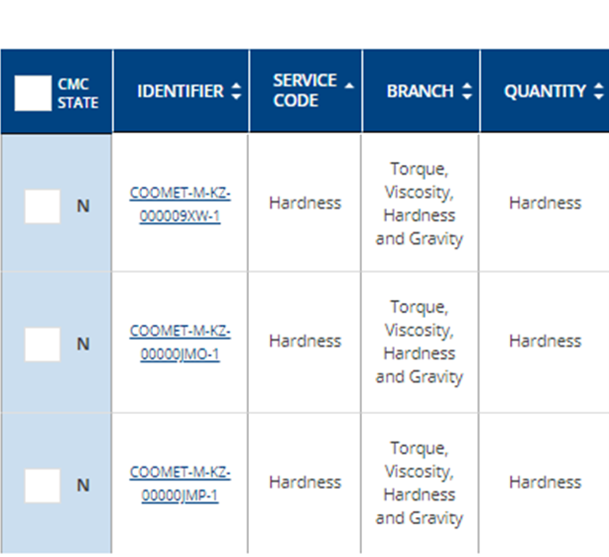
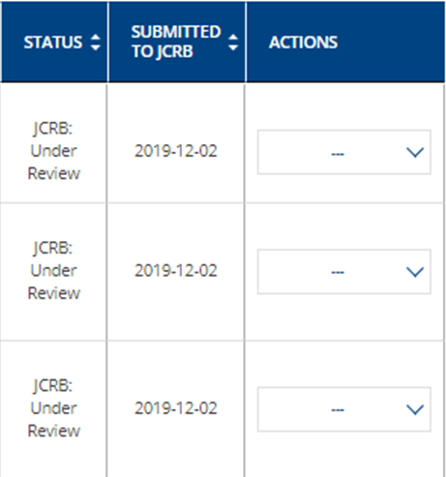
JCRB review: Writer
Writer can see CMC status from “my CMC space” menu
No actions allowed until the review is completed. Writer can read comments made by JCRB reviewers and TC Chair.

Slide 35
JCRB review: TC Chair (other RMO)
The addressed TC Chairs are requested to consult “JCRB request to review” to indicate
If they Will or Will not review
Indicate a date limit for the review

Slide 36
JCRB review: TC Chair (other RMO)
TC Chair can also see CMCs sent to review in “Pending actions” menu.
In this case, the system informs that TC Chair hasn’t yet indicated weather to review CMCs or not.

Slide 37
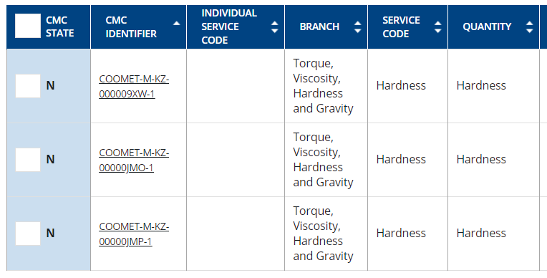
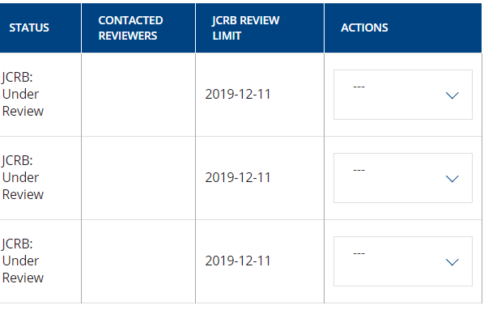
JCRB review: TC Chair (other RMO)
Once TC Chair indicates “will review” and indicates the date limit, CMCs will appear on the “CMC without reviewer” menu.
Date limit set by TC Chair = deadline for revision is visible here.

Slide 38
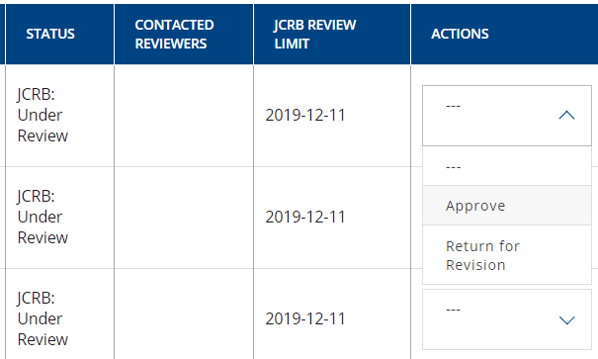
JCRB review: TC Chair (other RMO)
If all reviewing TC Chairs approve the CMC, the CMC will not be submitted to vote but will automatically become available to the KCDB Office for publication.
˅
TC Chair may review a CMC without engaging an external reviewer.
˅
˅

Slide 39
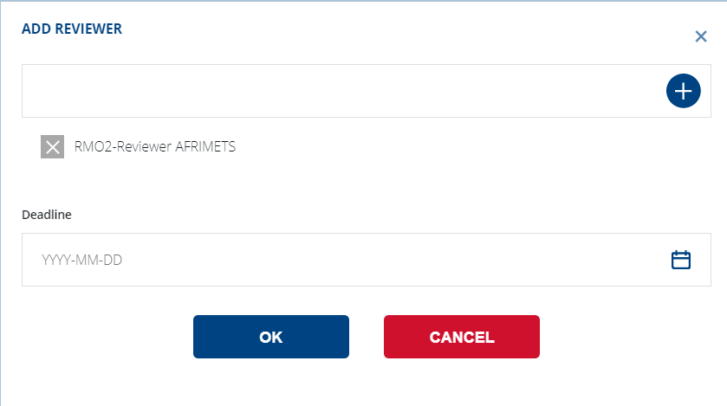
JCRB review: TC Chair (other RMO)
The TC Chair may ask experts within the same RMO to review one or several CMCs.
…all Reviewers that have user accounts and who cover the same expertise can be selected by the TC Chair.
˅
˅
˅
The date limits for review are set by the TC Chair.

Slide 40
JCRB review: Reviewer (other RMO)
Reviewer can see CMCs through the “JCRB” space menu

Slide 41
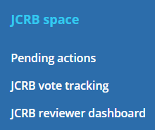
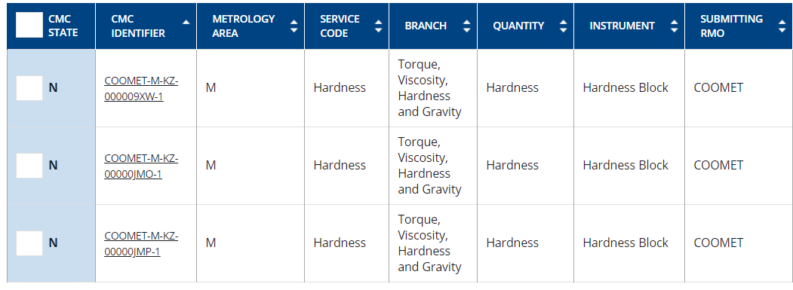
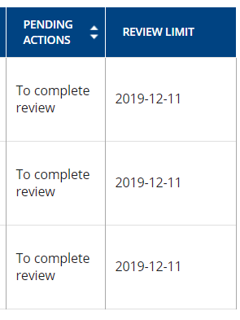
JCRB review: Reviewer (other RMO)
Reviewer can also see CMCs sent to review in “Pending actions” menu.
In this case, the system informs the deadline set by TC Chair to complete the review.

Slide 42
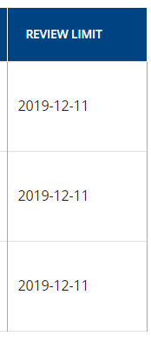
JCRB review: Reviewer (other RMO)
If the review is not completed before the date limit, the review will not be accepted..

Slide 43
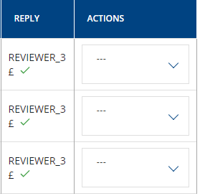
JCRB review: Reviewer (other RMO)
Reviewer can also see the review status from other RMOs.

Slide 44
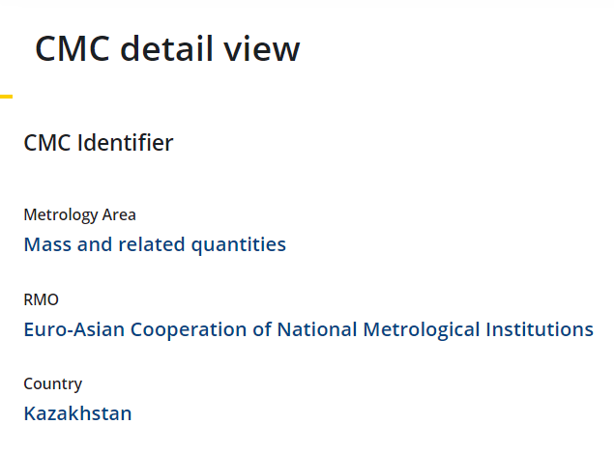
JCRB review: Reviewer (other RMO)
Reviewer can read and add comments specifying the type of comments (TECHNICAL, EDITORIAL, MISSING EVIDENCE, OTHER)
…or can add review report or other supporting document that helps to the revision process.

Slide 45
JCRB review: TC Chair (other RMO)
Reviewer has completed the review: the TC Chair can see:
green “tick” = “Accepted”
red “cross” = “not accepted”.

Slide 46
JCRB review: TC Chair (other RMO)
TC Chairs finalizes the review with “accept” or “return to review”
Reviewed CMCs that have been commented have their CMC ID in bold in the “JCRB CMC with reviewer” dashboard.

Slide 47
JCRB review: Originating TC Chair
If all reviewing TC Chairs approve the CMC, the CMC will not be submitted to vote but will automatically become available to the KCDB Office for publication.

Slide 48
JCRB review: Originating TC Chair
The TC Chair submits CMCs for vote in this dashboard.
CMC status “JCRB: Revision Completed”

Slide 49
JCRB review: TC Chair (other RMO)
The vote is done by clicking “Approve” or “Not approve”.
˅

Slide 50
JCRB review: all registered users
By clicking on the CMC ID, the details of the voting process are displayed.

Slide 51
My CMCs

Slide 52
Writer
Status and date of approval

Slide 53
WG CMC Chair
The WG CMC Chair represents the TC-Chairs within one metrology area. With an objective to avoid reviewing one CMC by several RMOs he may dispatch and suggest the CMC for review to the different RMOs.

Slide 54
WG-Chair
WG CMC Chair, has access via his profile to a form where all CMCs that have been submitted to the JCRB space for inter-RMO review are listed.

Slide 55
WG-Chair
The coordinator of a CMC WG, the WG CMC Chair, has access via his profile to a form where all CMCs that have been submitted to the JCRB space for inter-RMO review are listed.
The coordinator of the inter-RMO review (JCRB), mostly represented by the WG CMC Chair.
˅
˅
˅
˅
In the form, the WG CMC Chair may indicate his selection of which RMO(s) should review which CMCs.

Slide 56
JCRB review: TC Chair (other RMO)
The selected RMO TC Chair should indicate his wish to review in “JCRB request for review”.
If they Will or Will not review
Indicate a date limit for the review
RMOs that have not been selected are not prevented from registering their wish to review.

Slide 57
WG-Chair
RMO TC Chairs that have accepted to review are indicated with a green field in the form.

Slide 58
WG-Chair
The WG CMC Chair may review the CMCs himself without involving the TC Chairs when appropriate.

Slide 59
https://www.bipm.org/kcdb/ https://www.bipm.org/en/cipm-mra/kcdb.html#help
Author: BIPM
Version: 5
Last update: 2022-05-31

